Slide 1
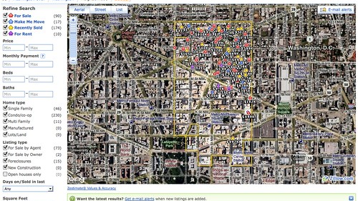
ETL – US Housing Project
Christine Brown, Doris Meiers,
Lizzie Stenhaug, Tana Larson,
Victoria Jeshurun,
December 15th, 2020
This Photo by Unknown Author is licensed under CC BY-SA

Slide 2

Outline
Extract Process
Transform Process
Load Process
Testing Database

Slide 3
E - Extract
Zillow housing data: https://www.zillow.com/research/data/
3 CSV files

Slide 4
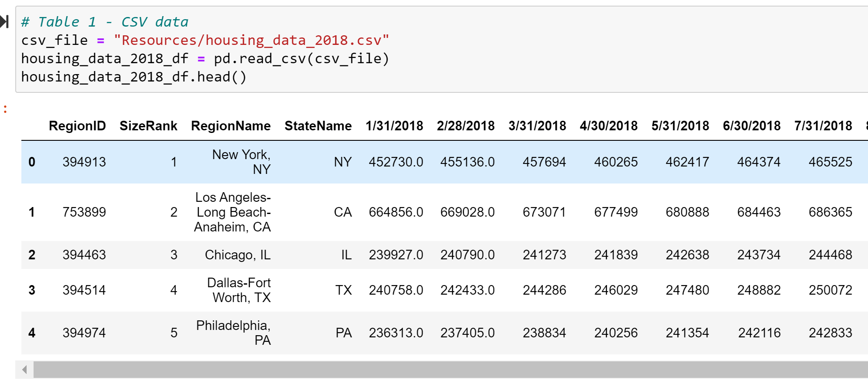
T - Transform

Slide 5
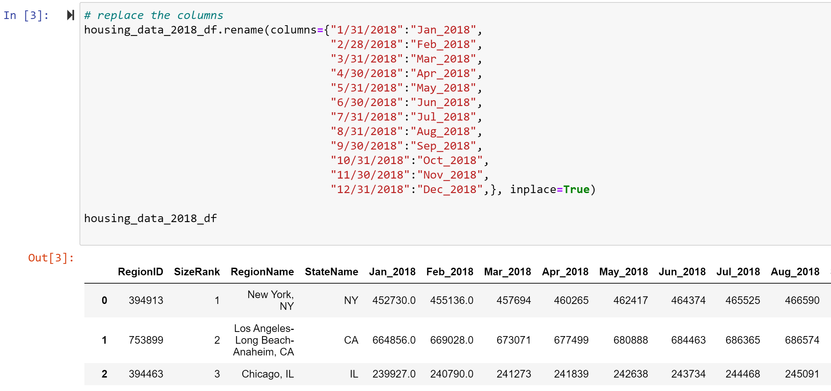
T - Transform

Slide 6
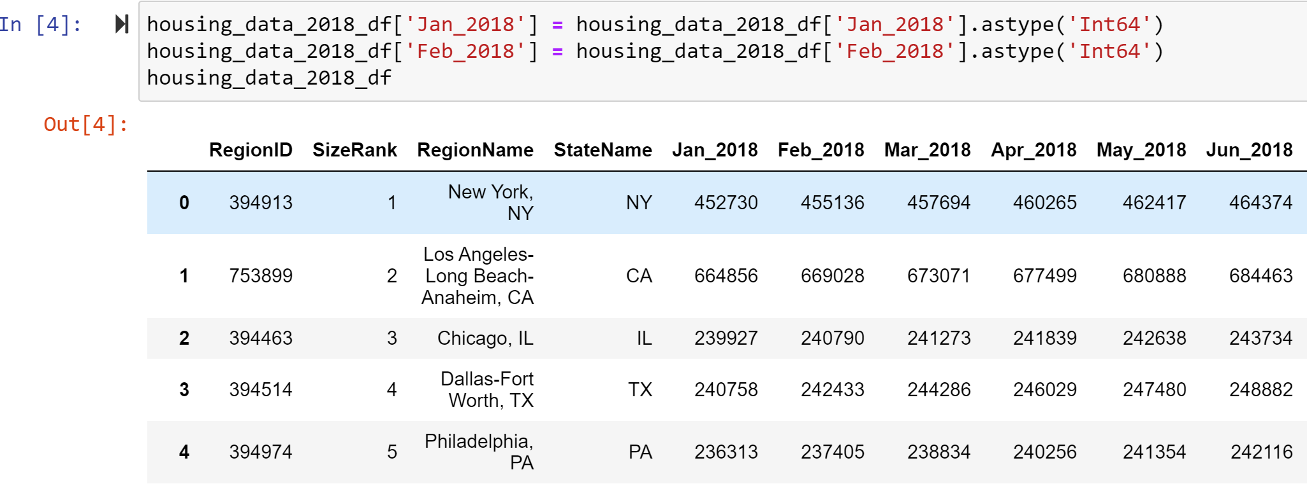
T - Transform

Slide 7
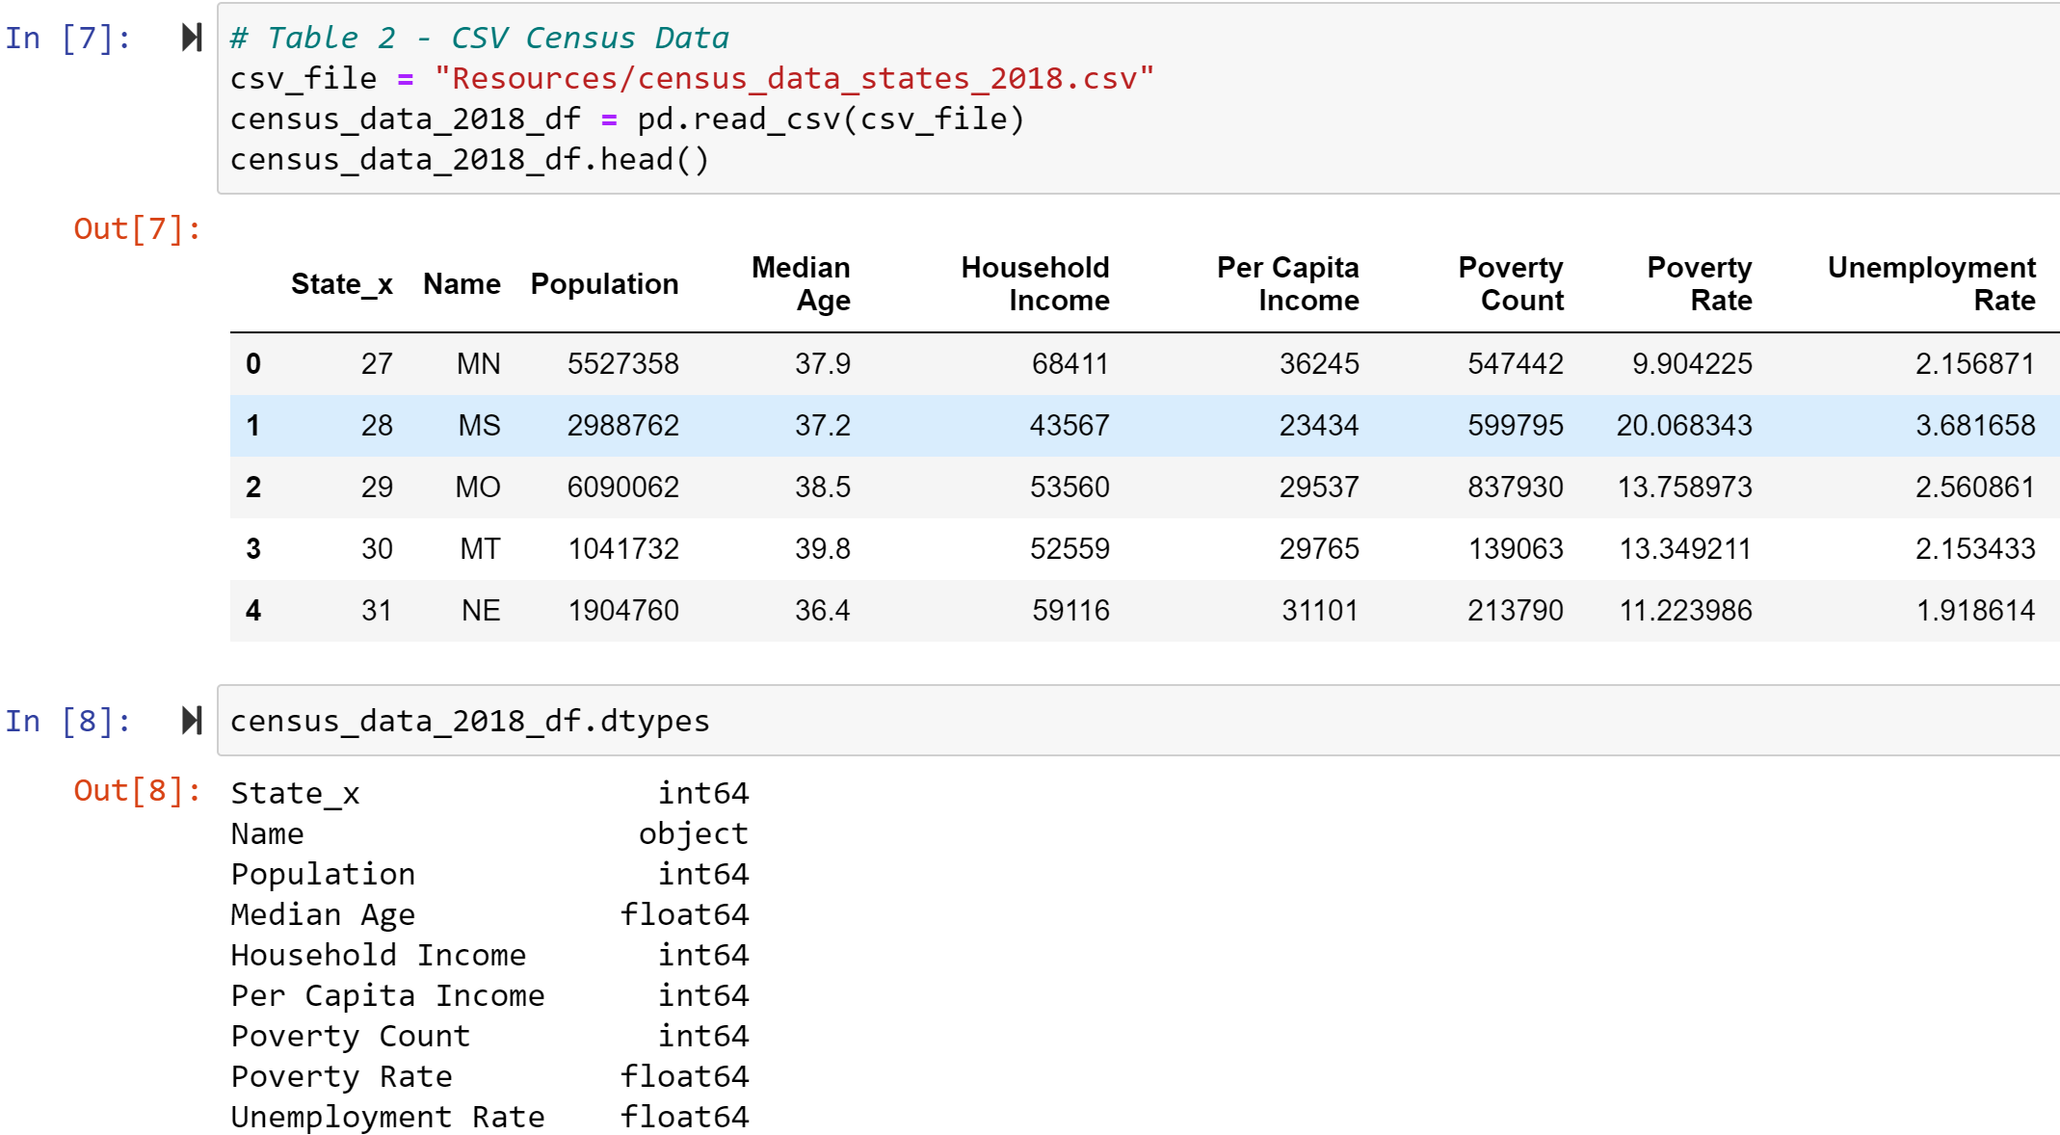
T - Transform

Slide 8
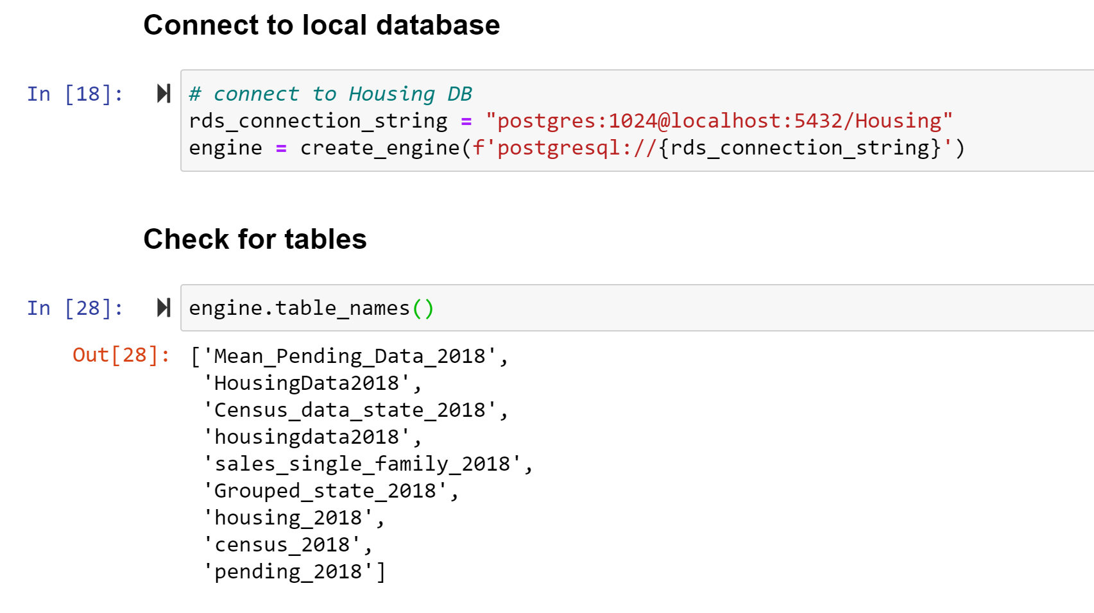
L - Load

Slide 9
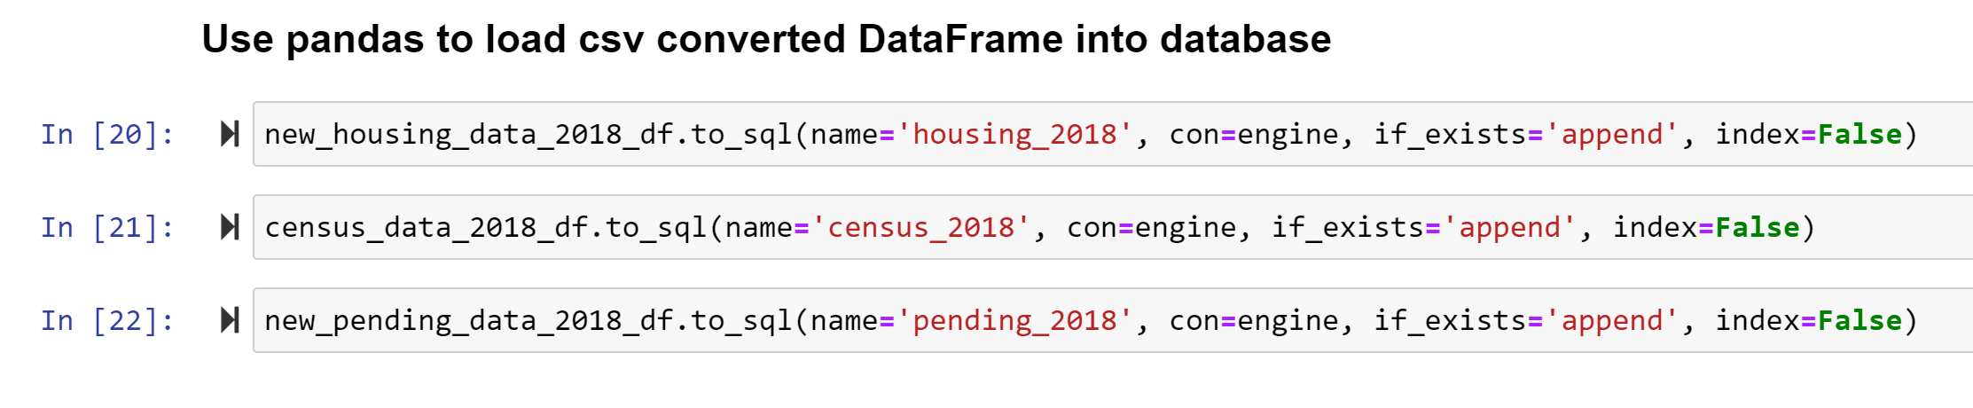
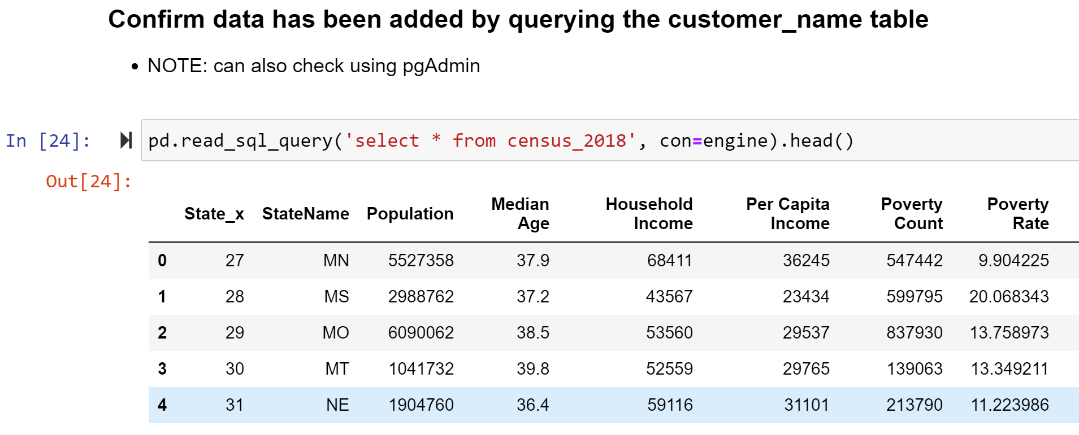
L - Load

Slide 10
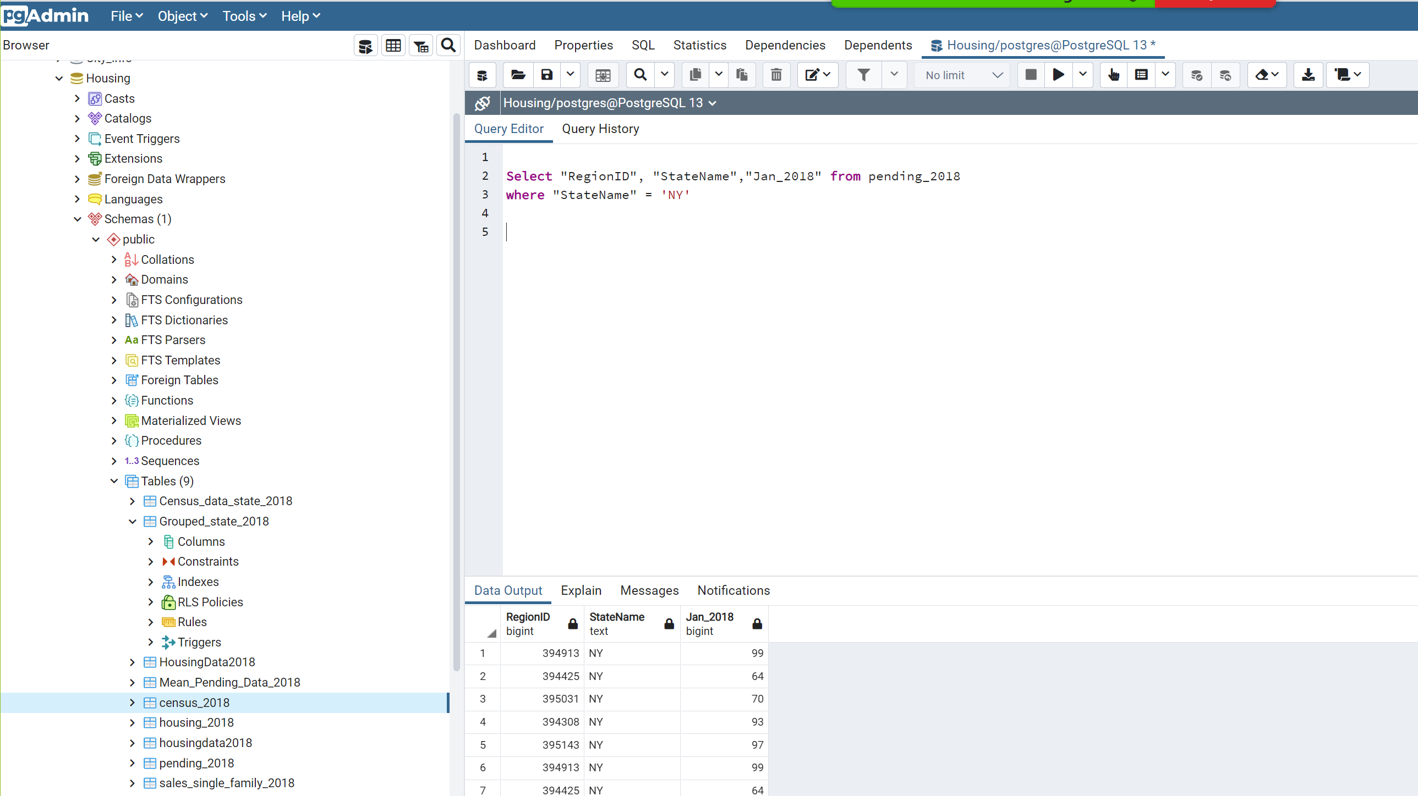
PostProgres DB Schema

Slide 11
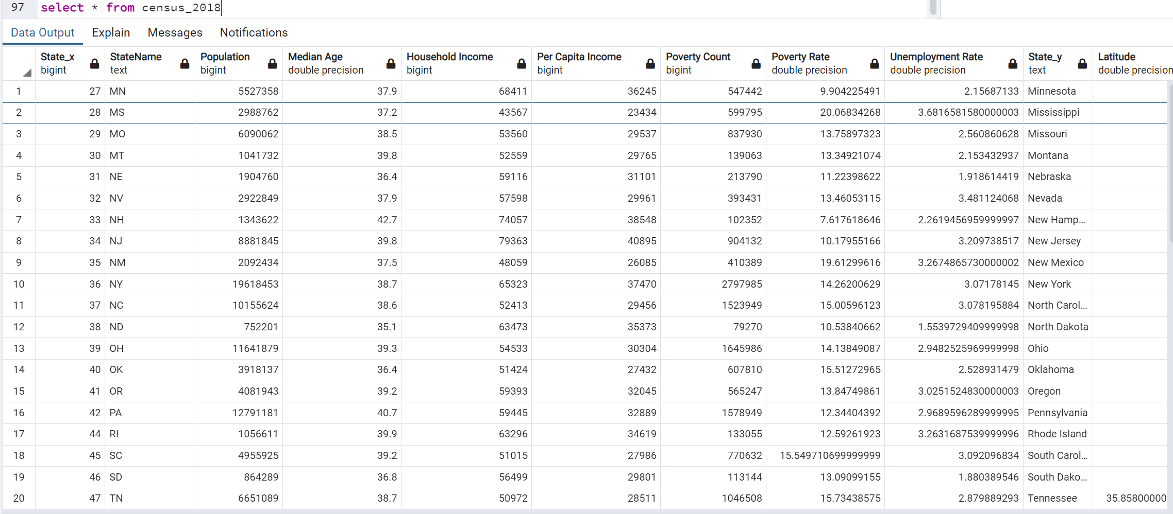
Query Progres DB

Slide 12
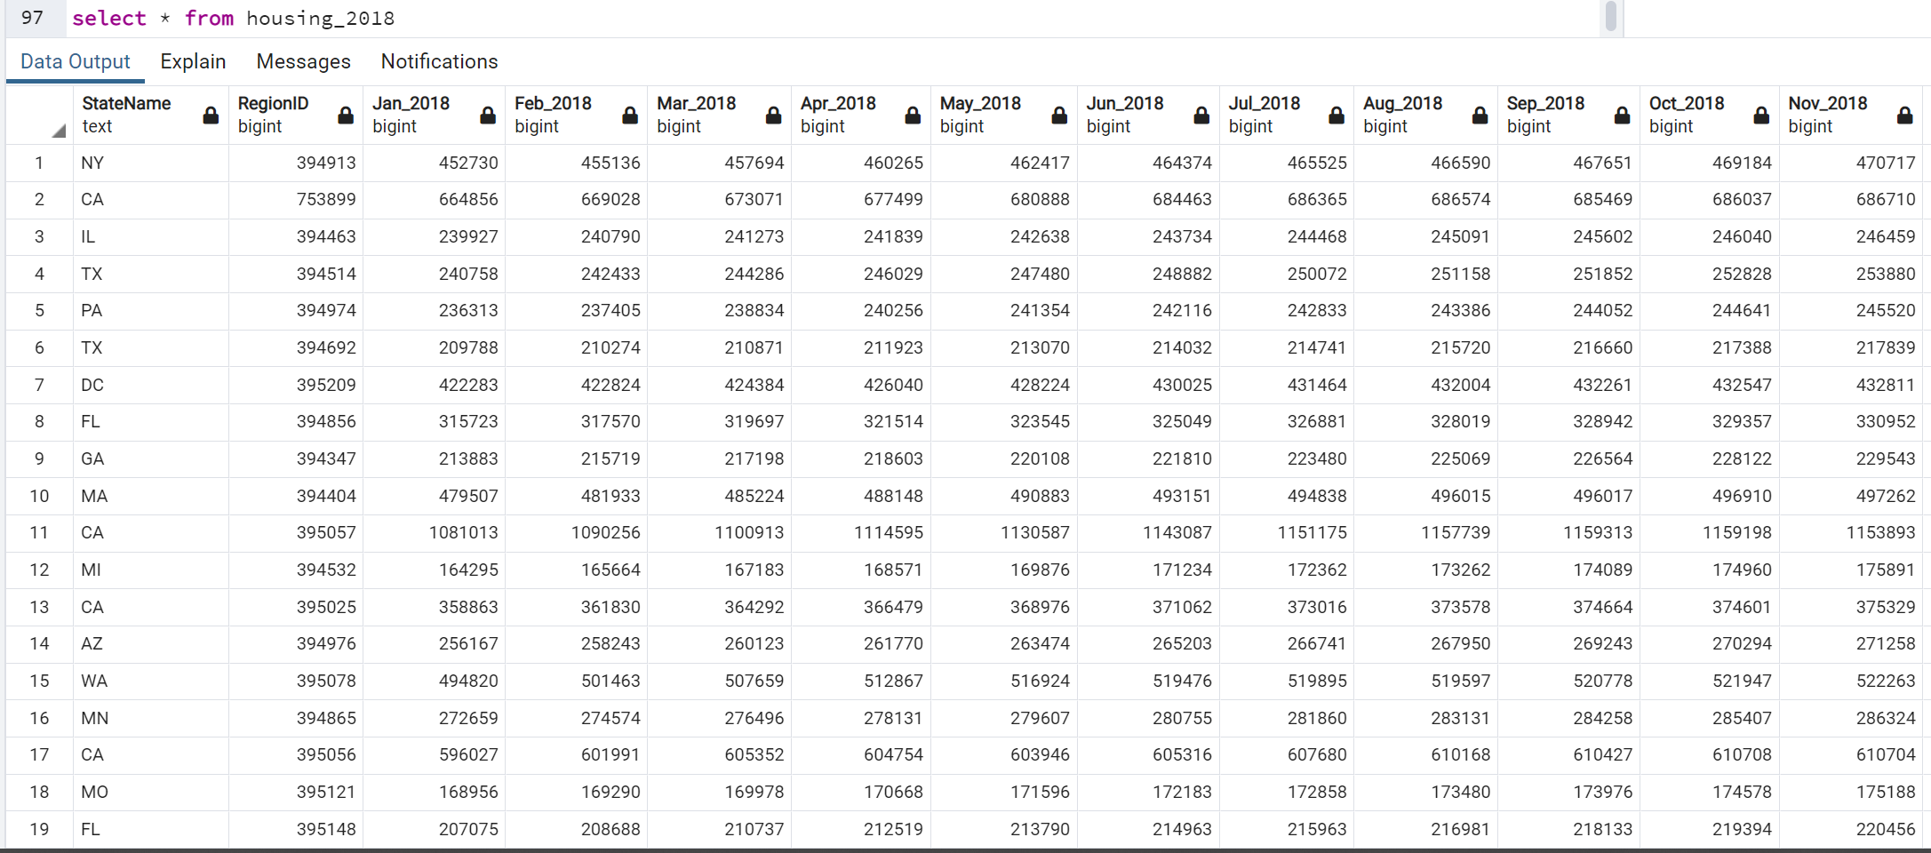
Query Progres DB

Slide 13
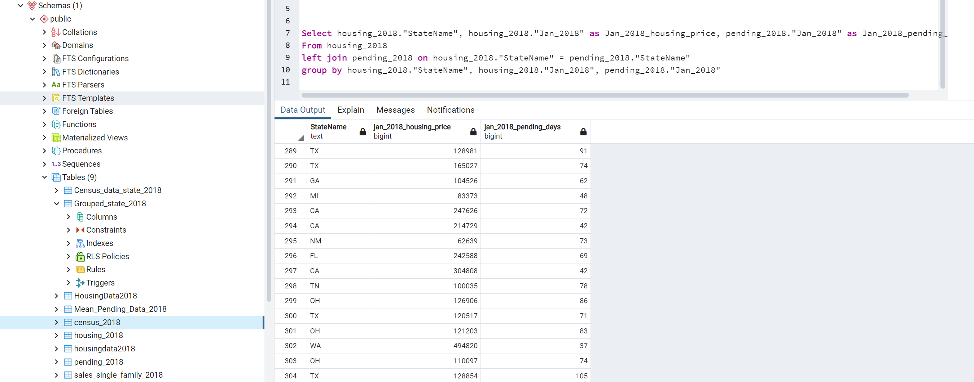
Query Progres DB – Joining tables

Slide 14
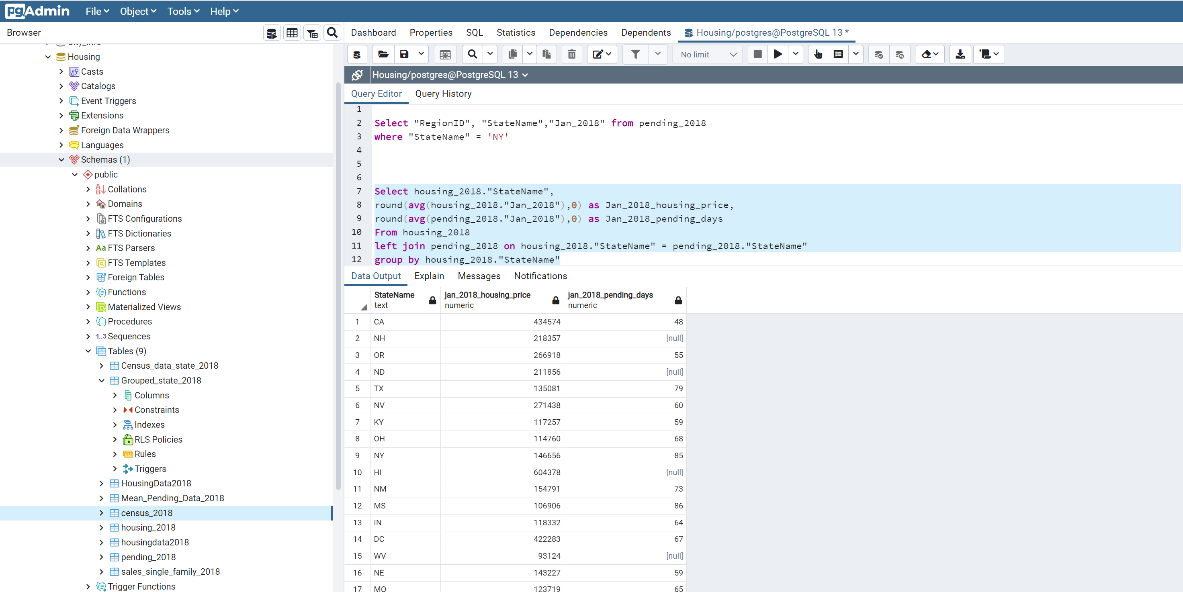
Query Progres DB – Summary Aggregation Table

Slide 15

Conclusion
Great exercise to learn the process
More time could have explored MongoDB

